Slide 1

INVENTORY ANALYSIS
Kandan S
23401037
MBA – DA
Sec - A

Slide 2
CONTENT
Introduction
Objective
Research Methodology
DEPARTMENT WISE PROFIT
TOP AND BOTTOM DISTRIBUTORS
ACTIVE AND IN ACTIVE STATUS BY DEPATMENT
FINDING THE SIGNIFICANT REORDER TYPE
NEW ITEM PURCHASE ANALYSIS
INVENTORY DASHBOARD
CONCLUSION

Slide 3

RESEARCH METHODOLOGY
Collected data from legacy software
Collected data is a real time data of 2018 -2024
Data Set contains 24912 rows and 59 columns
Data Preprocessing
After preprocessing 10684 rows and 15 columns
Tools used for analysis are:
Excel
Power BI

Slide 4

ABOUT DATASET.
The data was extracted from a legacy software .
From HOME AND NEEDS SUPER MARKET super market .
This data set contains of :
Department
Item
Distributor
Category
Cost
Selling
M.R.P
Create date of item
Active Status of item
Reorder type

Slide 5
AGENDA SLIDE
OBJECTIVE.
₀₁
₀₂
₀₃
DEPARTMENT WISE PROFIT
TOP AND BOTTOM DISTRIBUTORS
ACTIVE AND INACTIVE STATUS BY DEPATMENT
₀₄
₀₅
₀₆
FINDING THE SIGNIFICANT REORDER TYPE
INVENTORY DASHBOARD
NEW ITEM PURCHASE ANALYSIS

Slide 6
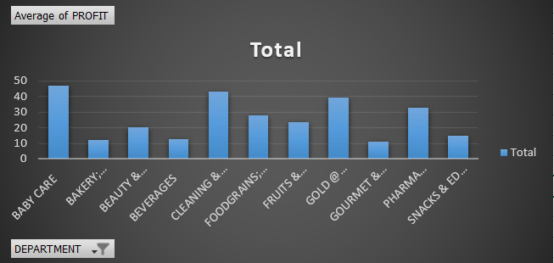
DEPARTMENT WISE PROFIT
Most Profitable Departments:
BABY CARE: Highest average profit at approximately 46.83.
CLEANING & HOUSEHOLD: Second highest average profit at approximately 43.15.
FOODGRAINS, OIL & MASALA: Also shows a high average profit.
Least Profitable Departments:
BAKERY; CAKES & DAIRY: One of the lowest average profits at approximately 12.43.
BEVERAGES: Another low-profit department with an average profit of approximately 12.58.
Notes:
Conclusion
The analysis reveals significant variability in profitability across different departments. The BABY CARE and CLEANING & HOUSEHOLD departments are the most profitable, while BAKERY; CAKES & DAIRY and BEVERAGES are the least profitable , such as focusing on high-profit departments for growth and exploring ways to improve profitability in lower-performing departments.

Slide 7

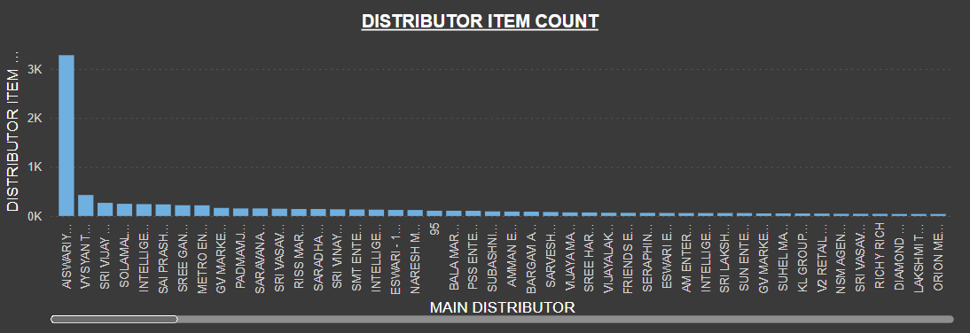
TOP AND BOTTOM DISTRIBUTORS
TOP 3
BOTTOM 3
AISWARIYA ASSOCIATES – OLIVIA : 3281
VYSYAN TRADERS PRIVATE LIMITED: 428
SRI VIJAY AGENCIES: 268
SRI ANNAI AGENCY - SWEETS; BISCUTS: 1
SRI GANESSA MALIGAI - SGM: 1
RIGHT AGENCY:1

Slide 8
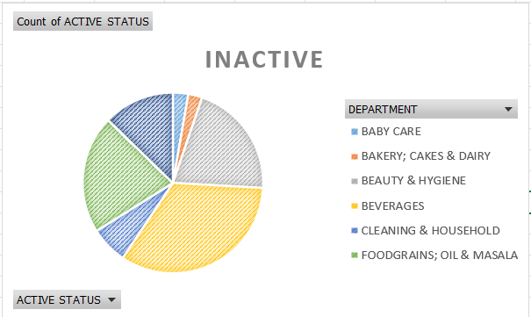

IMAGE HEAVY CONTENT SLIDE
ACTIVE AND IN ACTIVE STATUS BY DEPATMENT
Highest Proportion of Inactive Items: The BEVERAGES
department has the highest proportion of inactive items at approximately 14.1%.
Significant Proportions: The BEAUTY & HYGIENE
department also has a notable proportion of inactive items at approximately 8.7%.
Moderate Proportions: The CLEANING & HOUSEHOLD
department has a moderate proportion of inactive items at approximately 2.8%.
Low Proportions: Departments such as BABY CARE
and BAKERY; CAKES & DAIRY have relatively low proportions of inactive items, both under 1.2%.

Slide 9
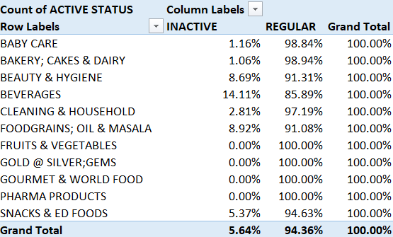
Conclusion
The analysis indicates that certain departments, specifically BEVERAGES and BEAUTY & HYGIENE, have a significantly higher proportion of inactive items compared to others. This suggests that these departments may require more attention to manage inventory and reduce the number of inactive items.

Slide 10
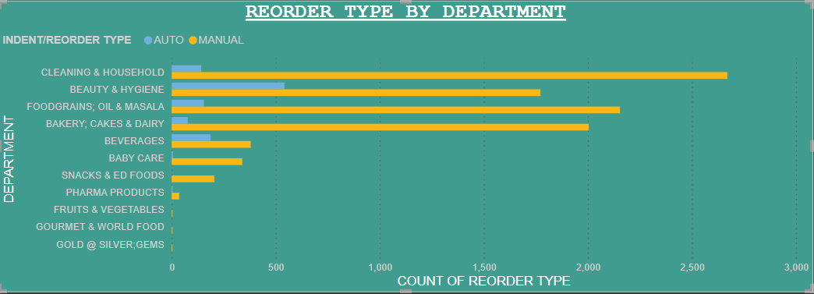
FINDING THE SIGNIFICANT REORDER TYPE
MANUAL: 9569 occurrences
AUTO: 1114 occurrences
Insights
Dominance of Manual Reorders: The 'MANUAL' type has a significantly higher frequency compared to the 'AUTO' type, indicating that manual reorders are much more common.

Slide 11
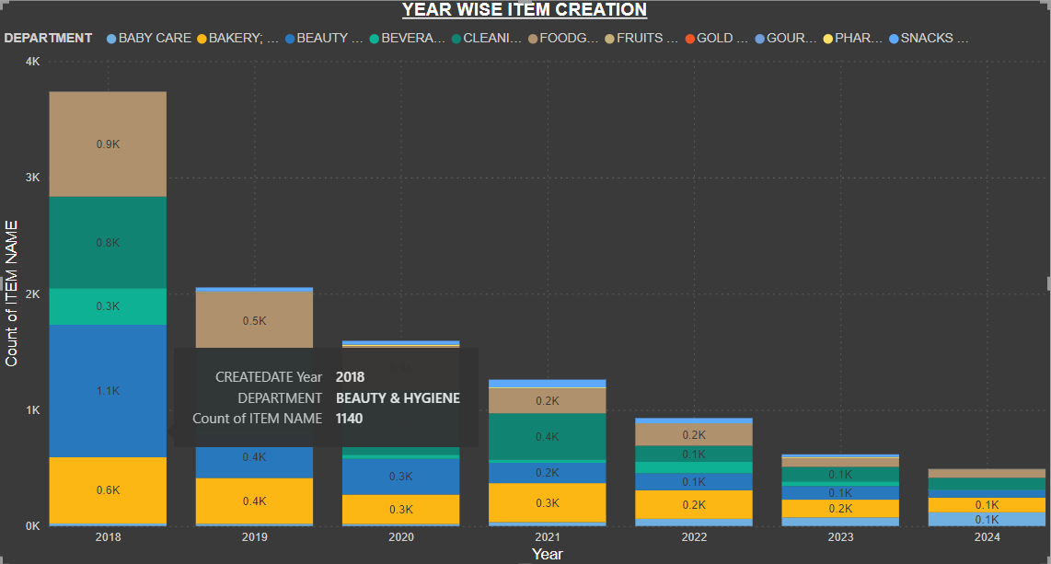
NEW ITEM PURCHASE ANALYSIS
High Variability: There is a significant disparity in item counts across different categories and years, with some categories
consistently having high counts while others have minimal counts.
Top Contributors: Cleaning & Household, Beauty & Hygiene, and Foodgrains, Oil & Masala are the top contributors to the overall
item count.
Yearly Decline: There is a noticeable decline in the total item count over the years, from a high of 3,739 in 2018 to 491 in 2024.
Category Focus: The data suggests a strong focus on categories like Cleaning & Household and Beauty & Hygiene, while categories like Gold & Silver, Gems, and Gourmet & World Food have minimal focus.

Slide 12
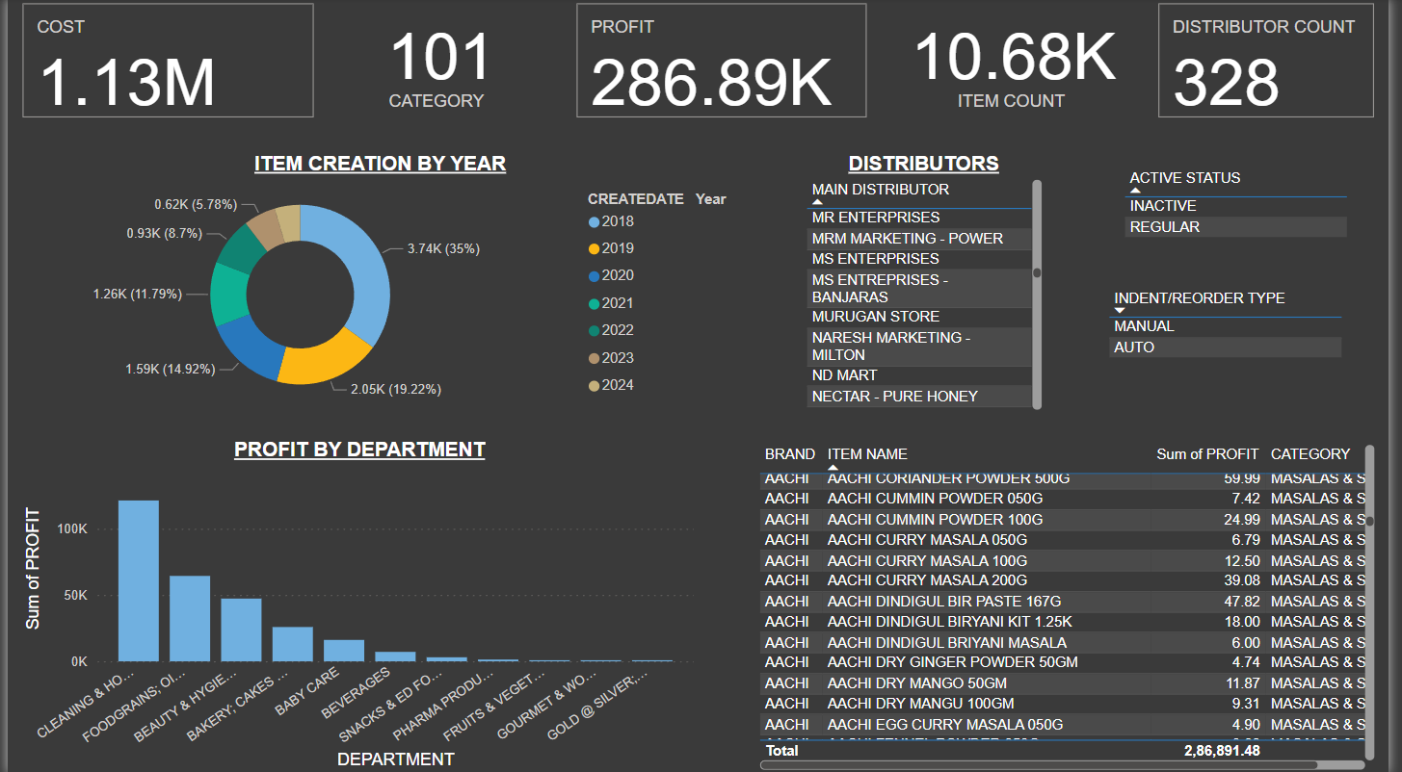
INVENTORY DASHBOARD

Slide 13
CONCLUSION
In leveraging Power BI for data visualization, we have gained critical insights that significantly impact our business strategy.
In essence, project has equipped with the knowledge needed to make informed decisions to enhance sales performance, product strategies, and overall profitability.
As such, the results of this project will continue to be a valuable asset for the company's growth and success.
In conclusion, the sales analysis project has provided valuable insights into the company's sales performance and strategy effectiveness.

Slide 14
Thank you.
END SLIDE

